Slide 1
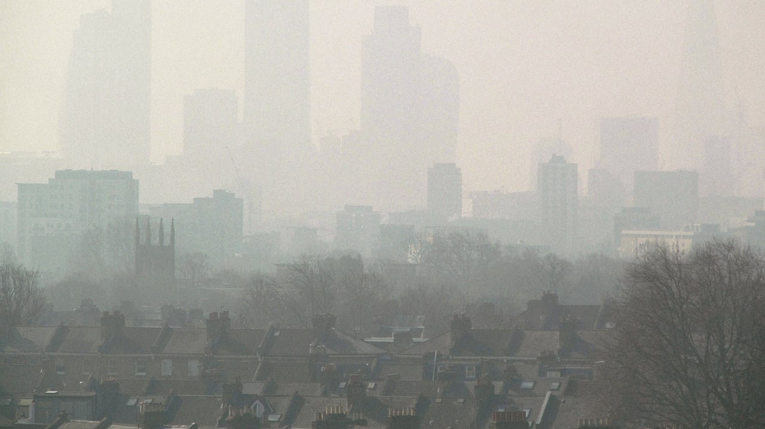
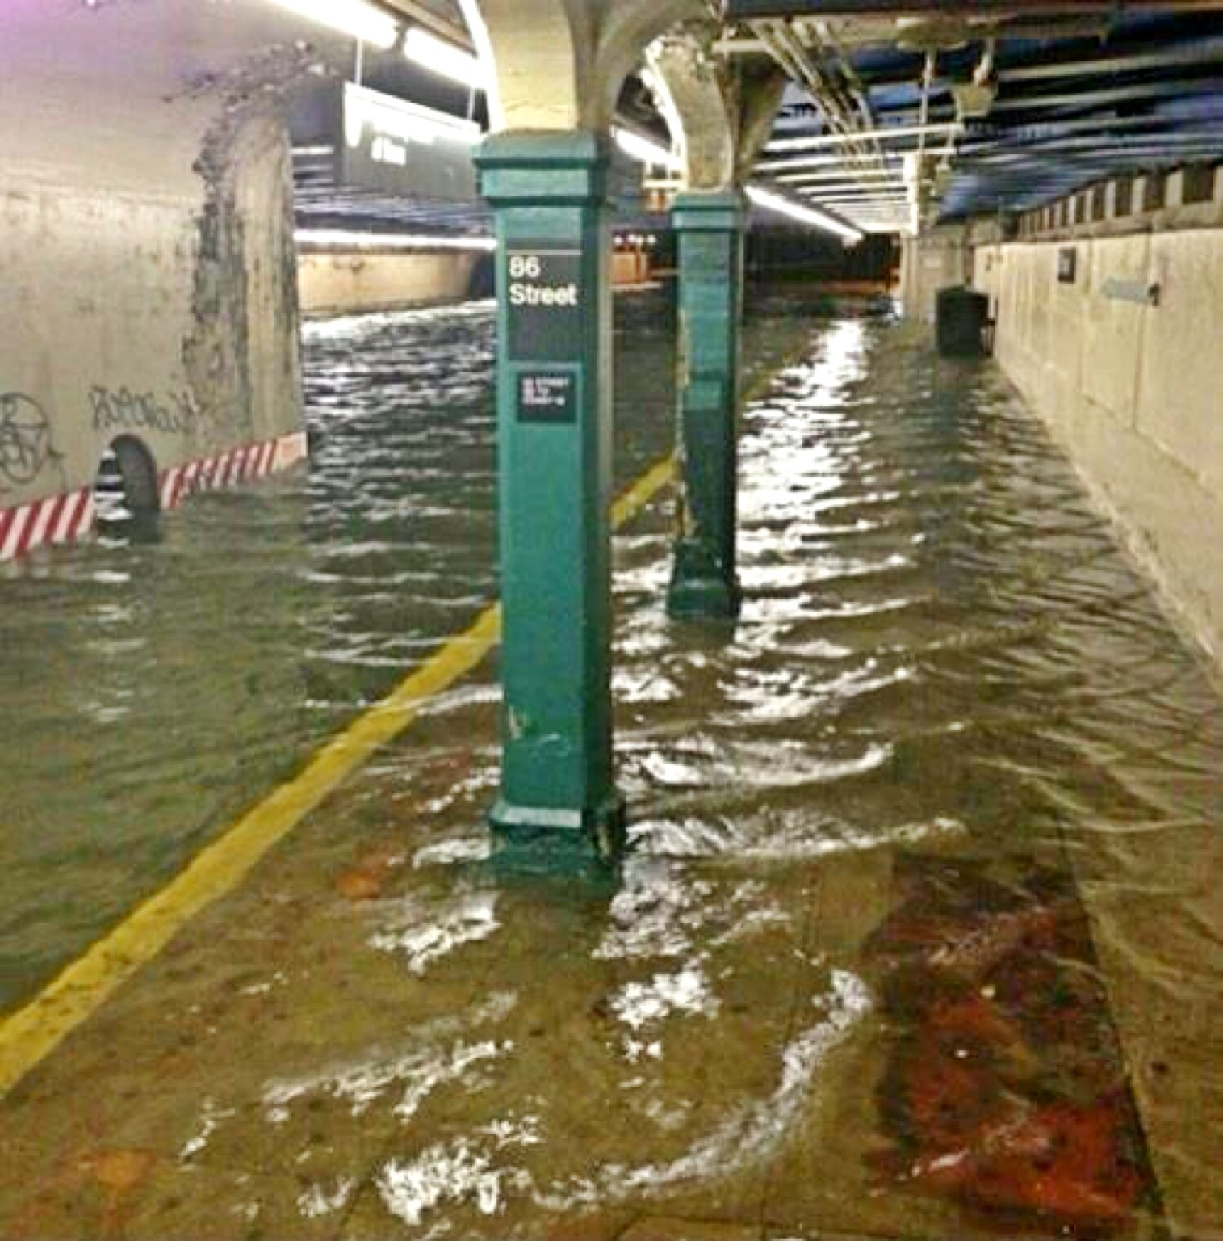
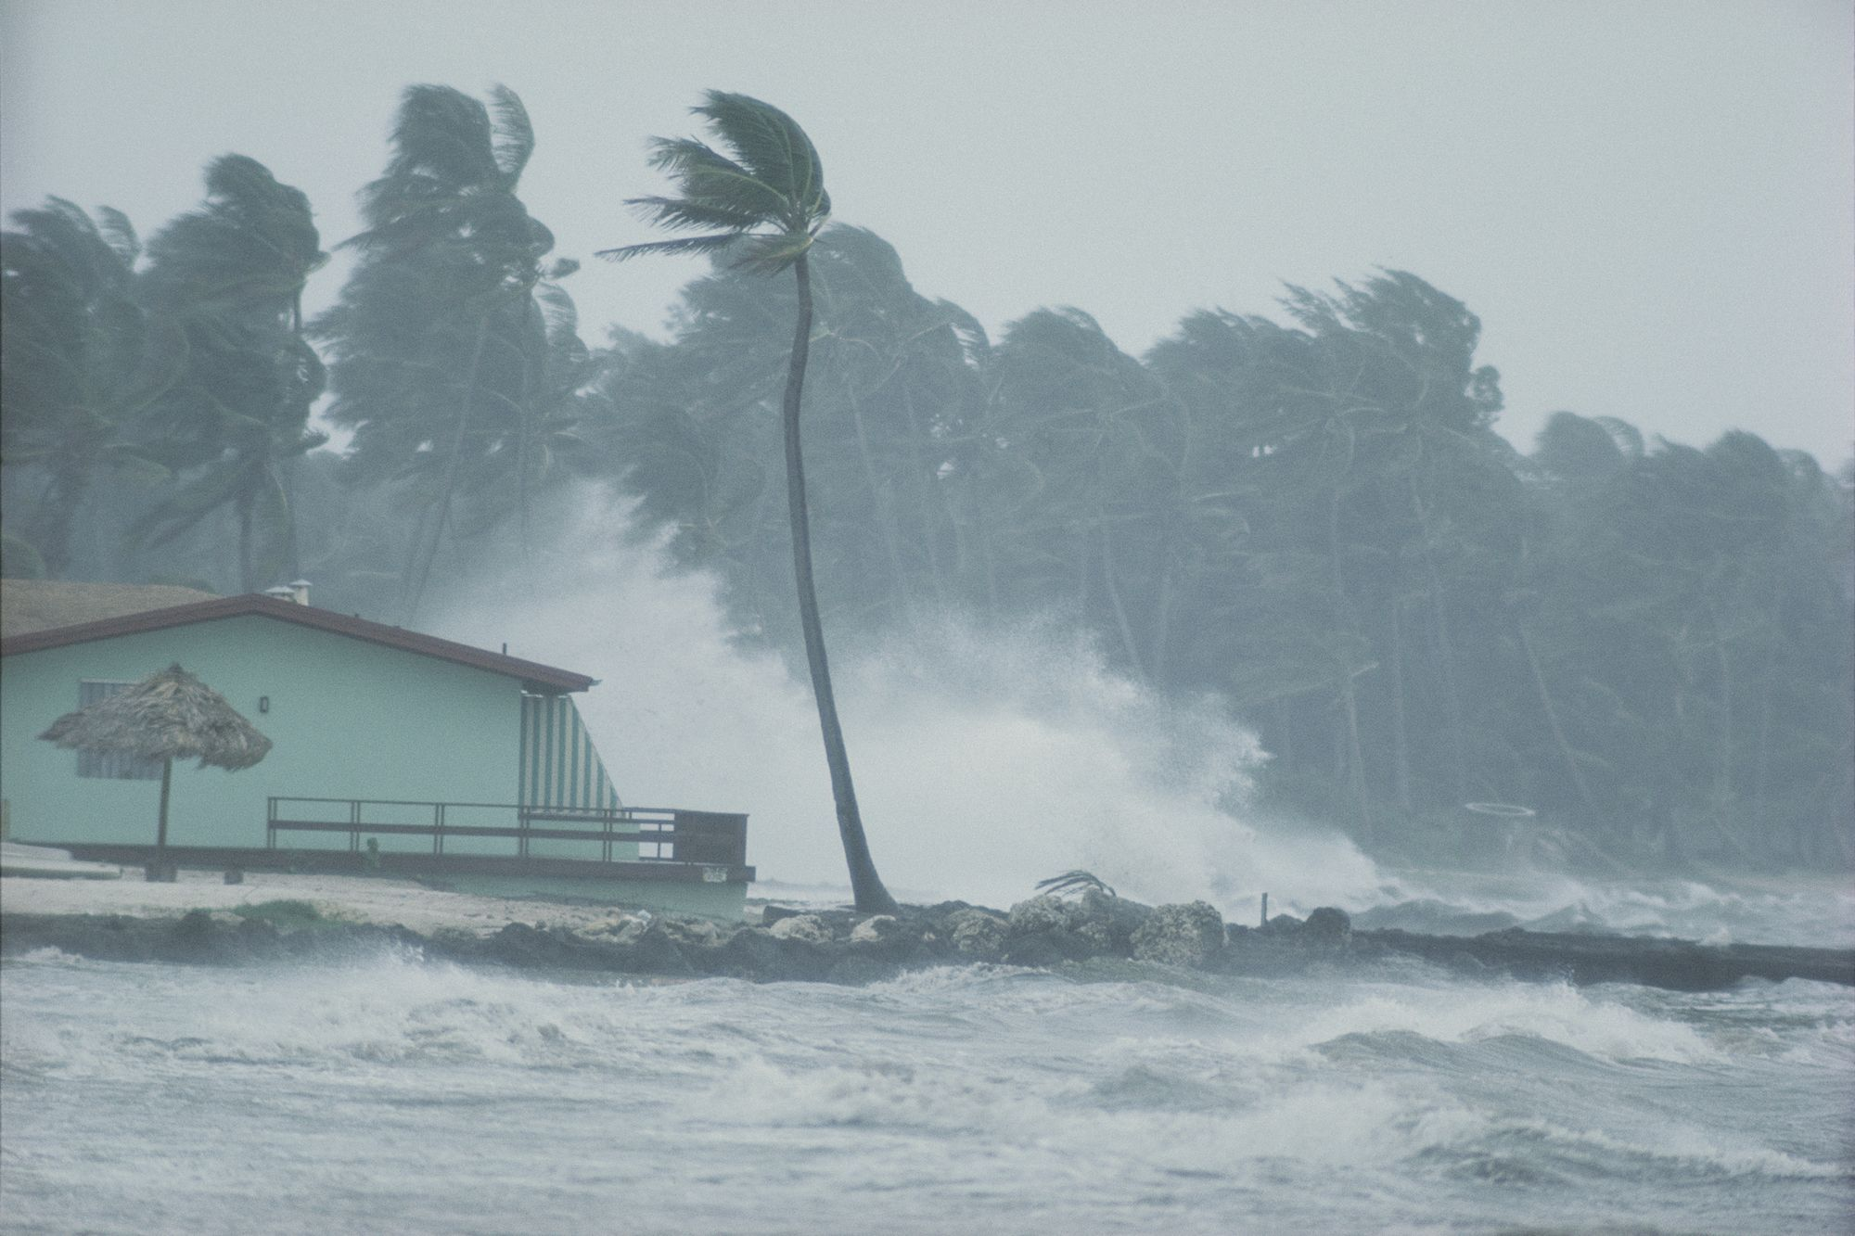



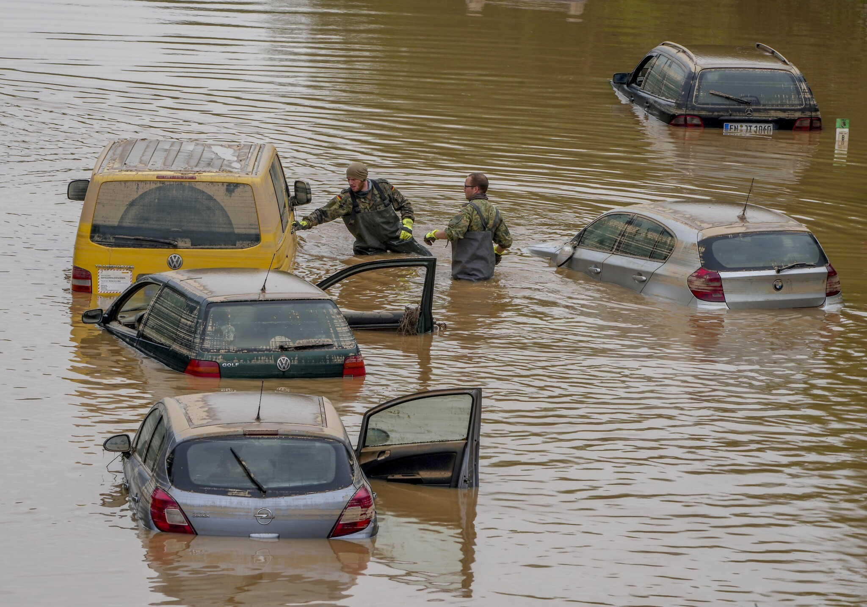

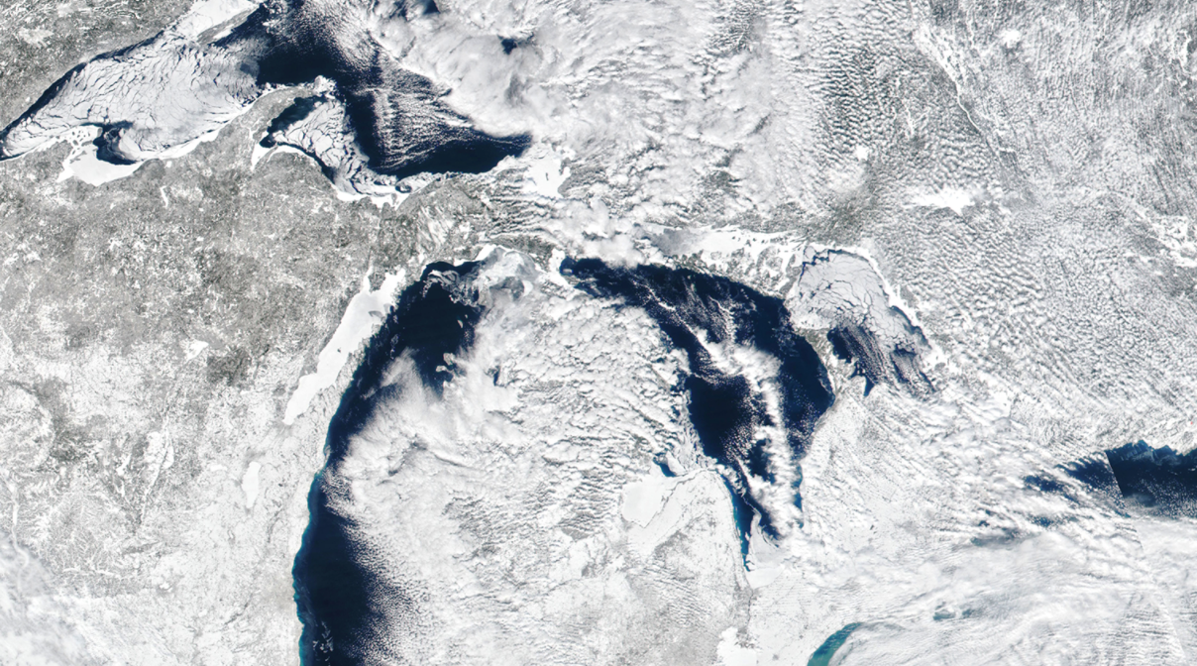

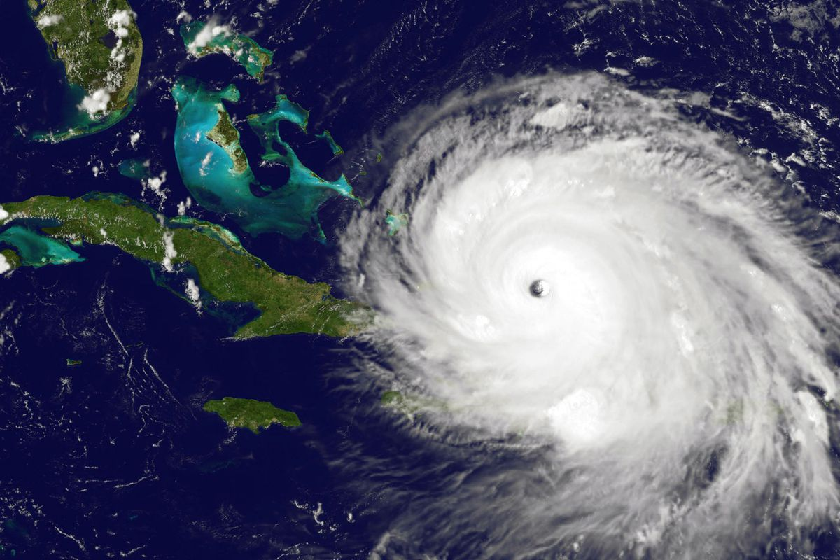
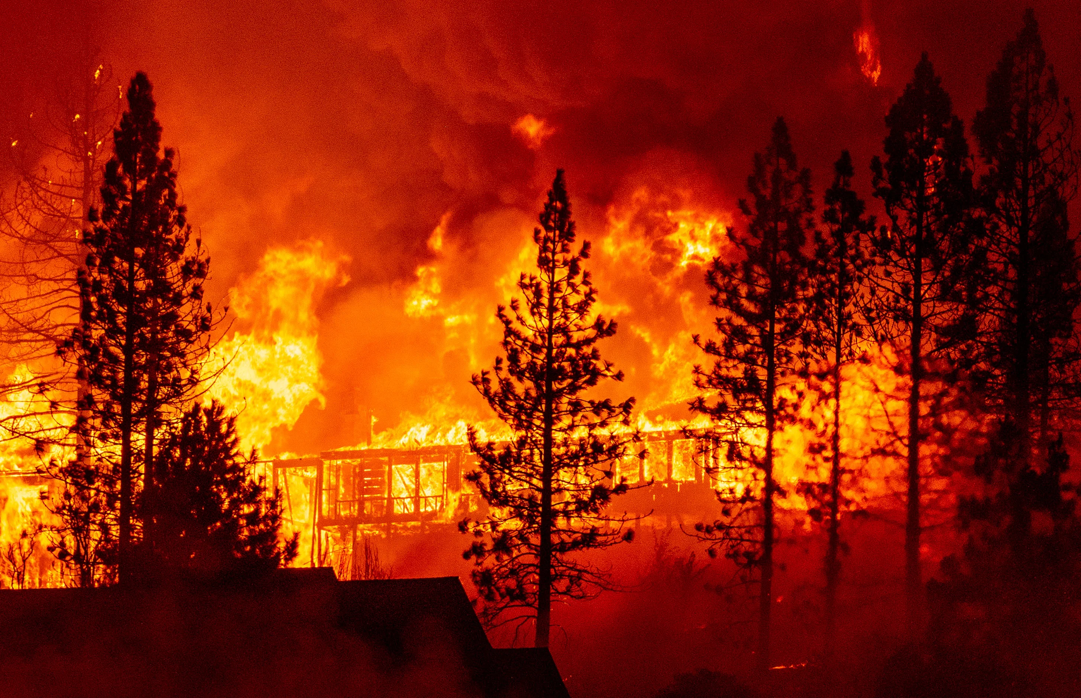
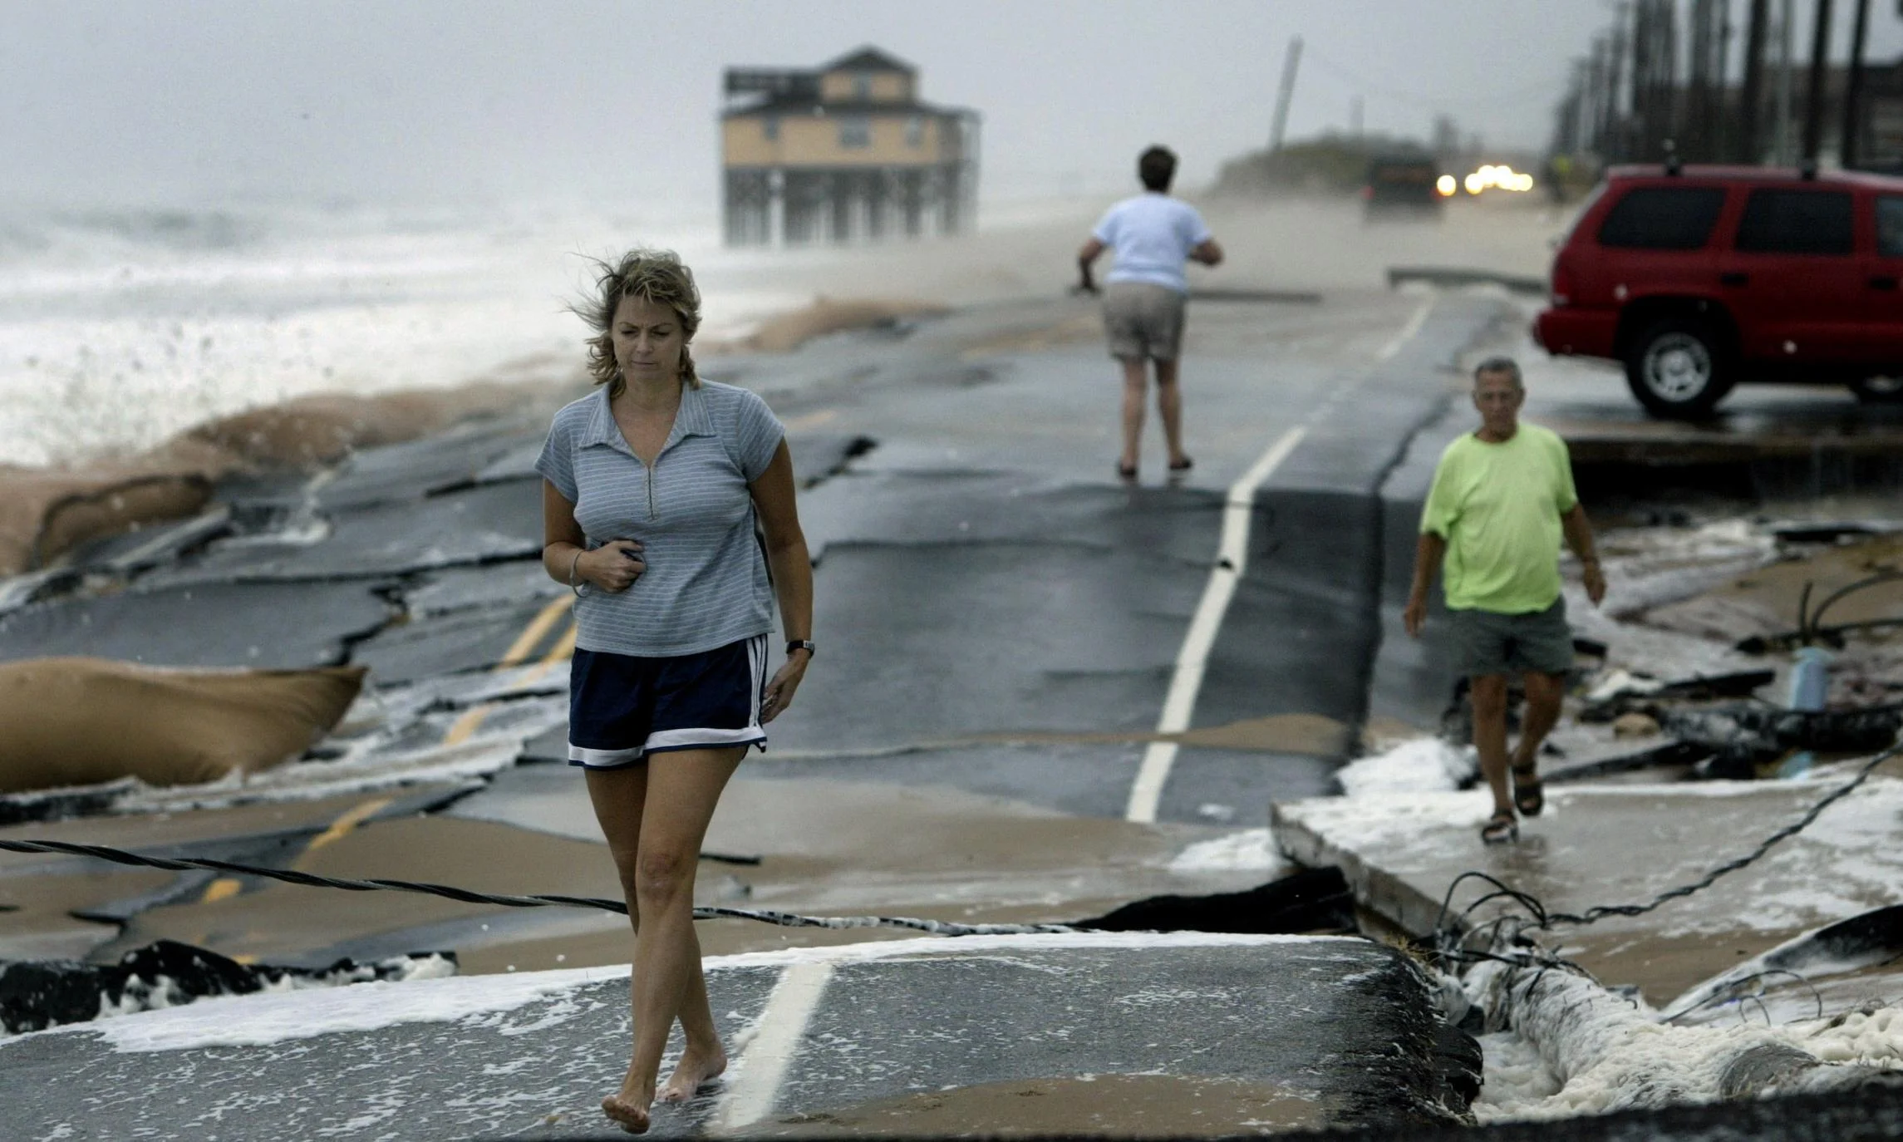

Climate Solutions for Riverdale
Joel Grayson
Notes:
Hello everyone. I want to tell you in five minutes about climate solutions I have been working on for Riverdale: solar panels, electric leaf blowers, and electric school buses.

Slide 2




Energy Sources in U.S.
Black=Fossil Fuels
Source: eia.gov/energyexplained/us-energy-facts
Data as of 2020
Notes:
These are the sources of electricity in the United States. Fossil fuels (in black) make up the majority. The two sources that do not emit are nuclear and renewables. These two need to scale up to replace fossil fuels in order to lower our emissions.
Scraps
I believe the government should fund nuclear programs. Currently, regulations are so expensive for nuclear power. France and China have figured out a way to create nuclear power at a large scale.

Slide 3
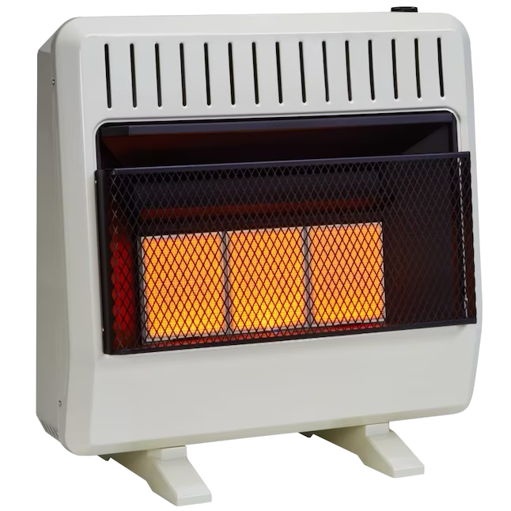

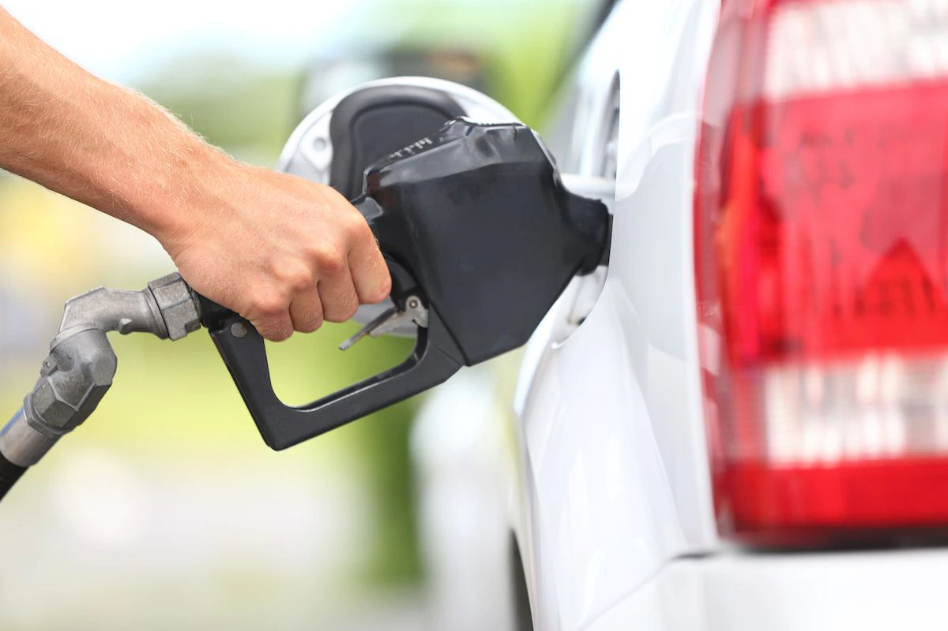
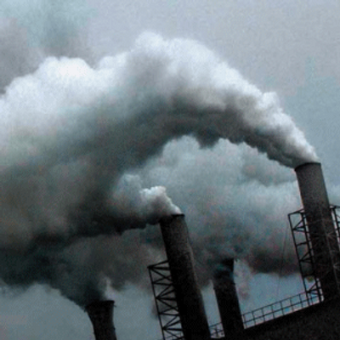
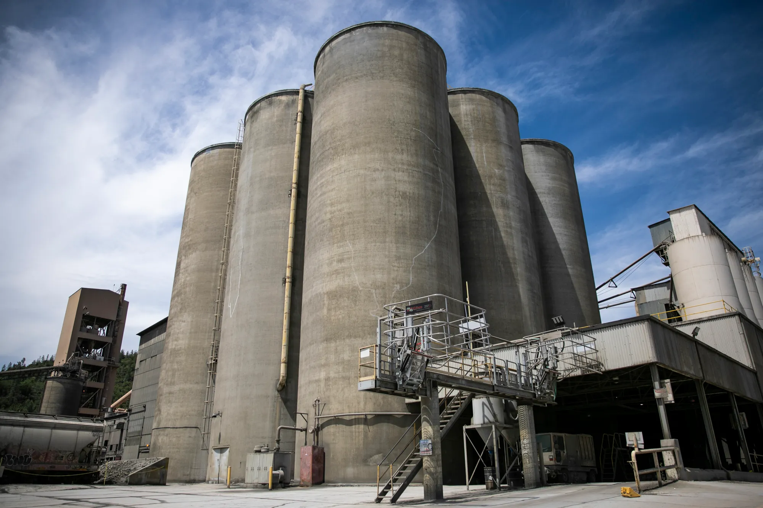
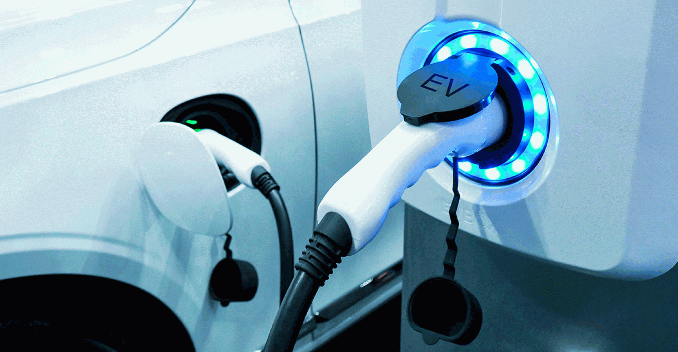
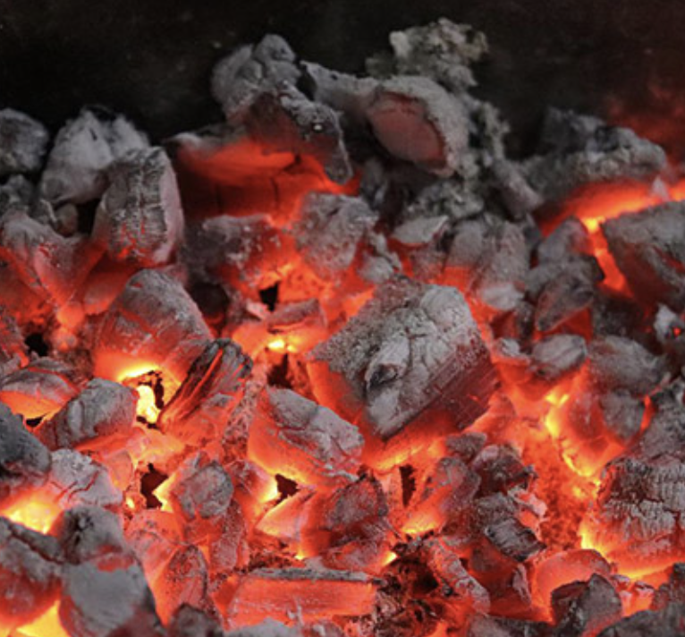
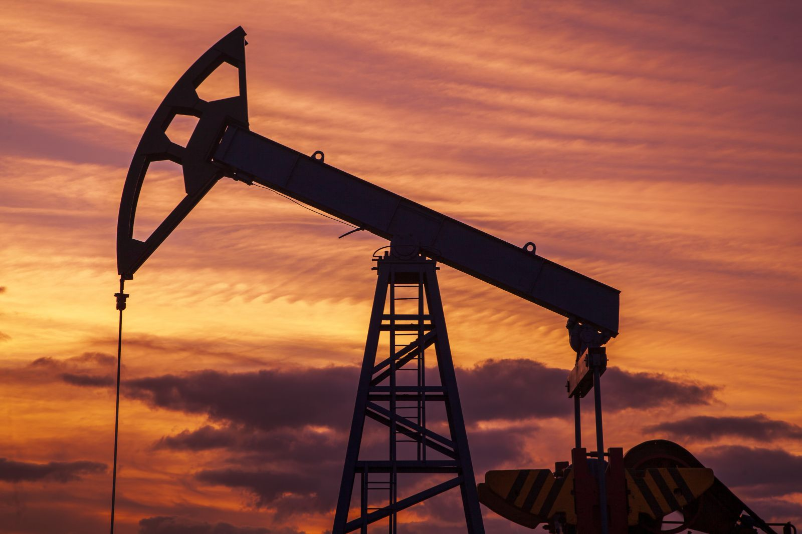


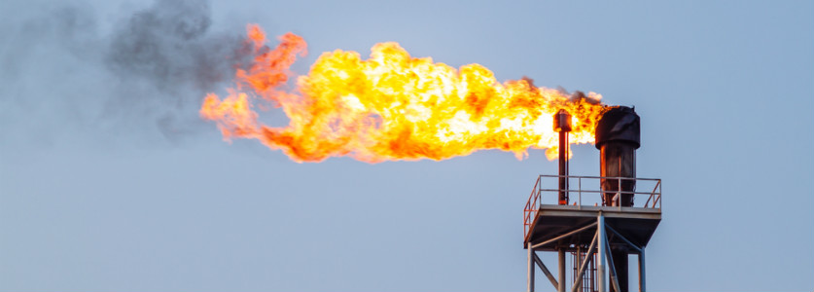

Clean Electricity
Electrification
Heaters
Vehicles
Factories
Renewables
Nuclear fills in gaps
Fossil Fuels
Notes:
Listen up, this is important. [slow] I believe the solution to climate change is through electrification and producing clean electricity.

Slide 4
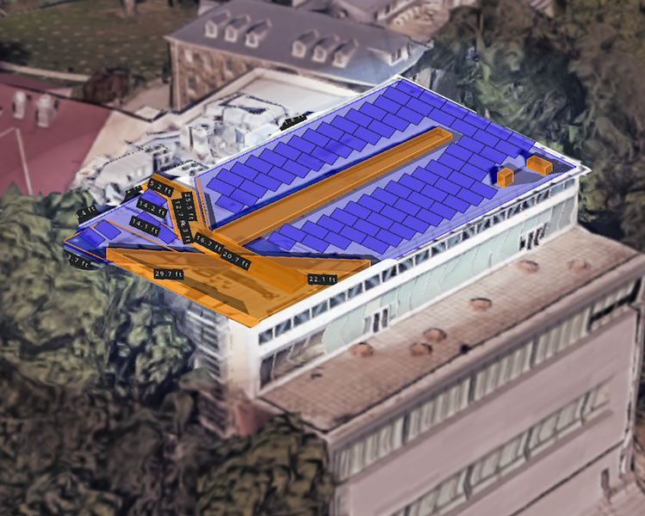
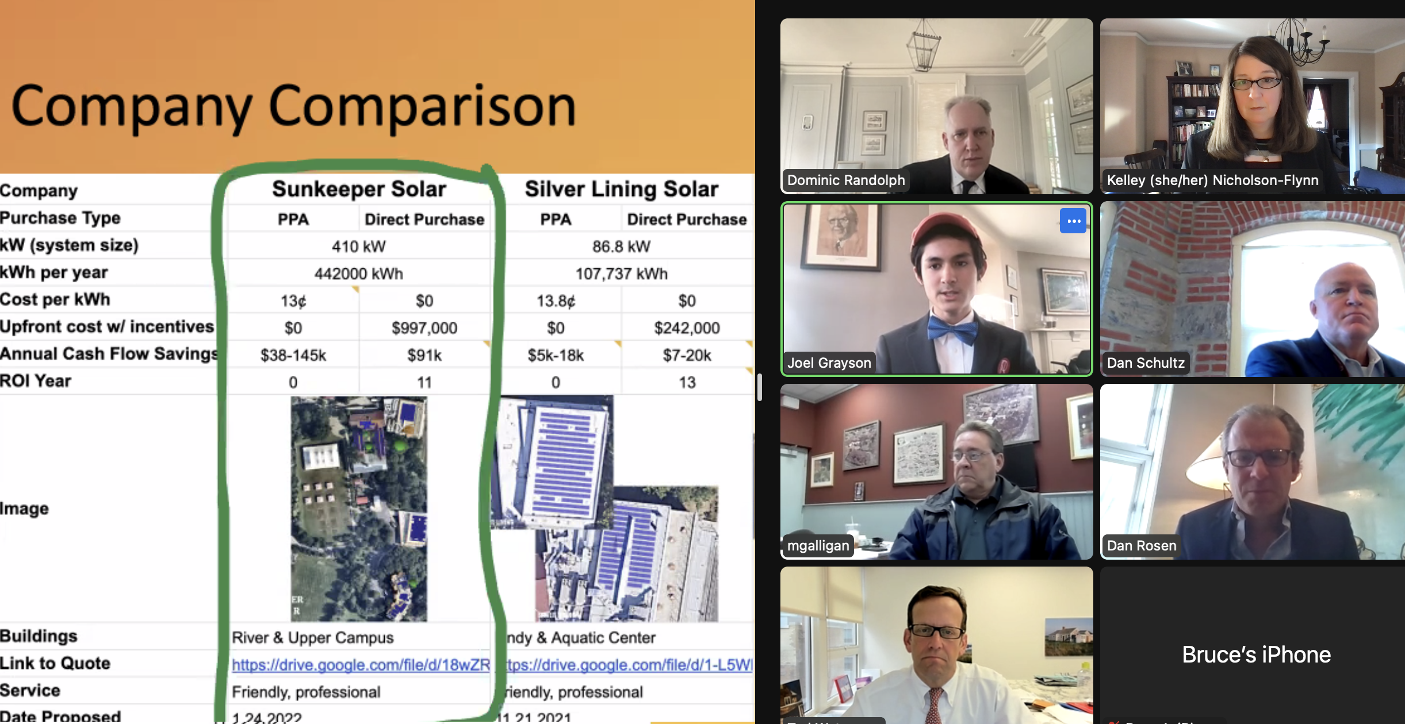
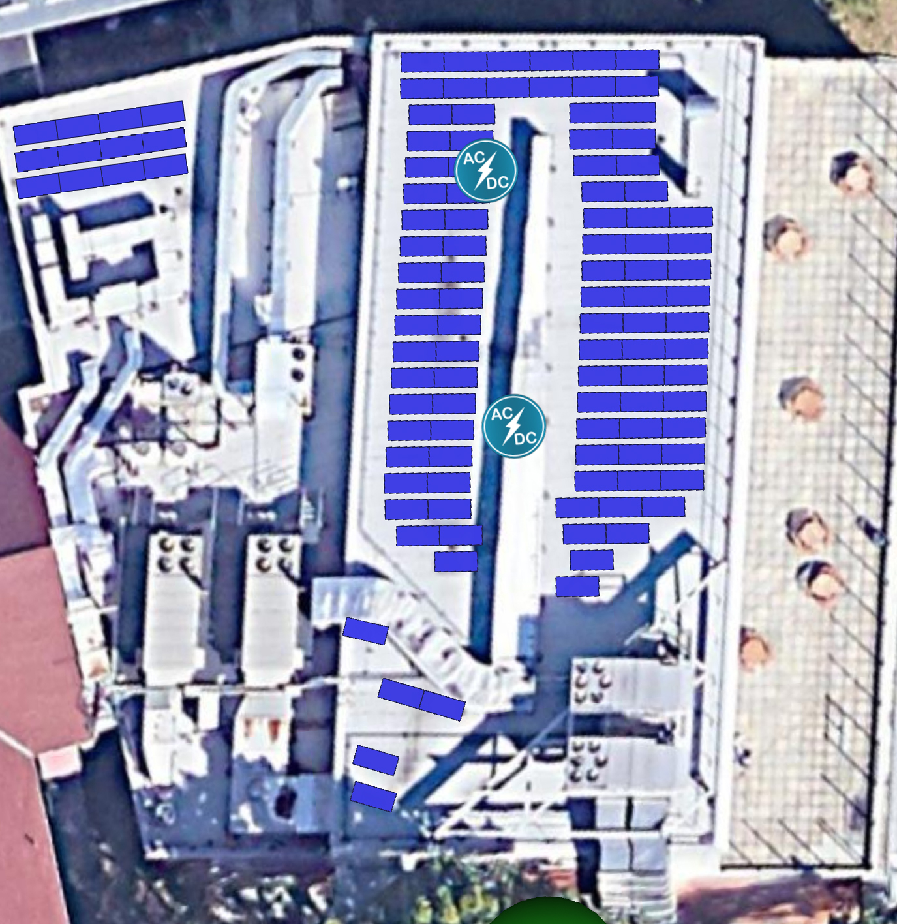
Solar for Riverdale
Making Solar Models
Presenting to the Board of Trustees
Notes:
Clean Electricity
I have been working to get solar panels for Riverdale with the administration. Two years ago, I measured the rooftops and made solar models (point laser, and met with solar companies to get quotes. Last year, I spoke with Riverdale’s administration and presented to the board of trustees.

Slide 5
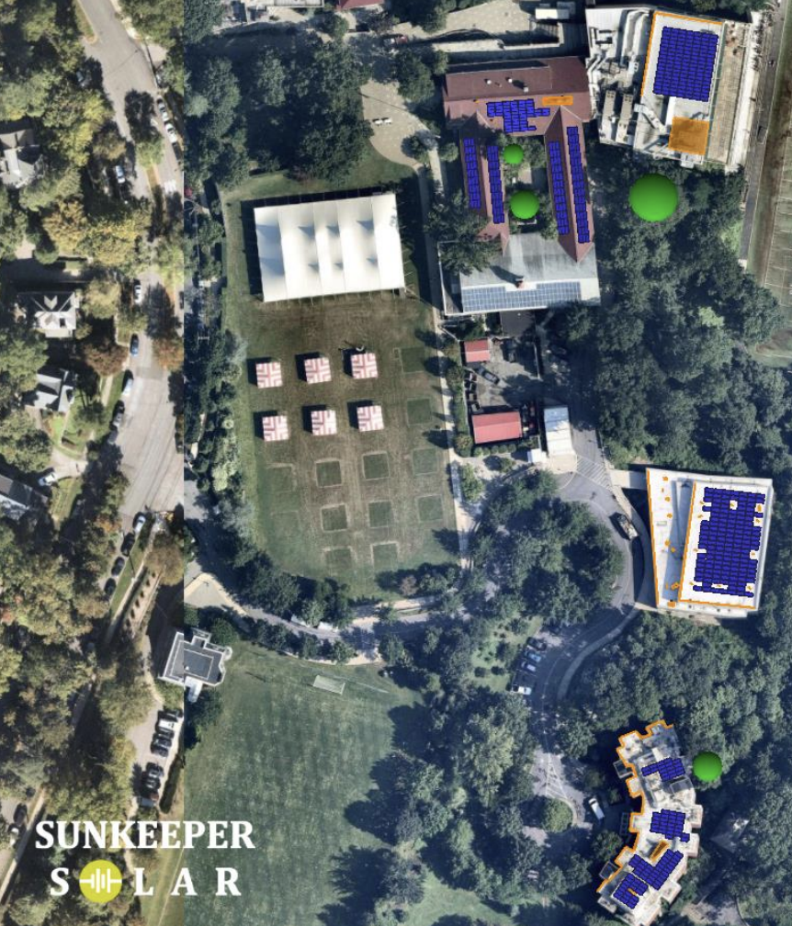
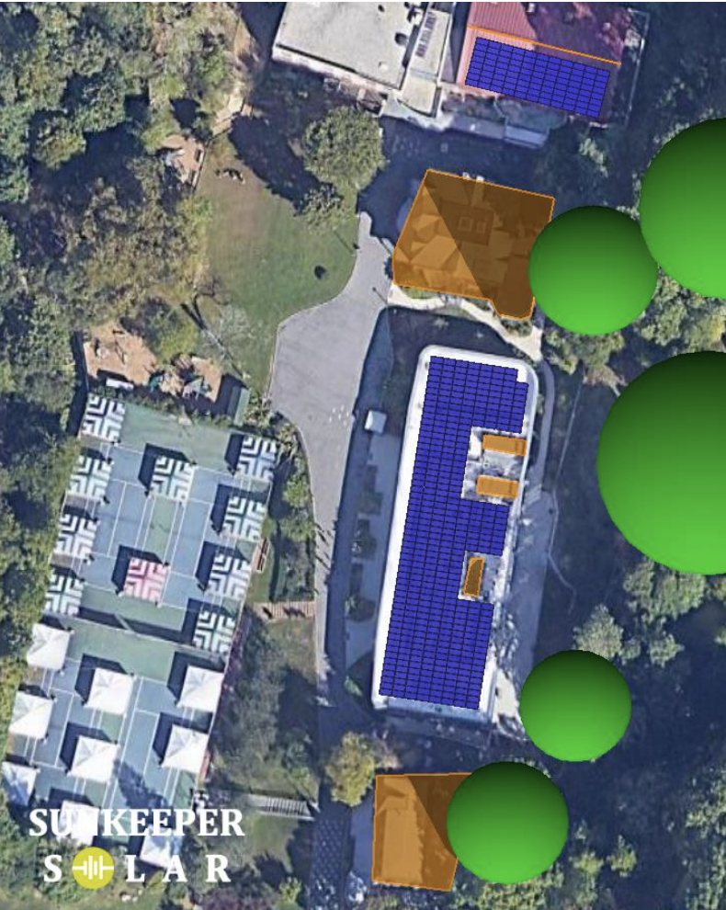
Annual Impact
Generate 442 MWh/yr.
(15% total electricity usage)
Promote clean energy
(6 buildings)
Hill Campus
River Campus
Notes:
I am happy to say that a contract is being written for a 410 kW installation that will cover 6 buildings. Hopefully you all (point to 9th and 10th graders) will be able to see it before you graduate.

Slide 6
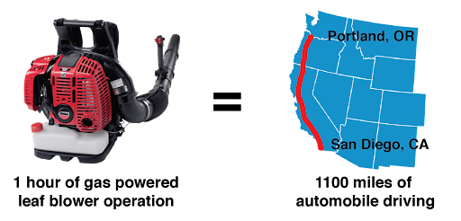
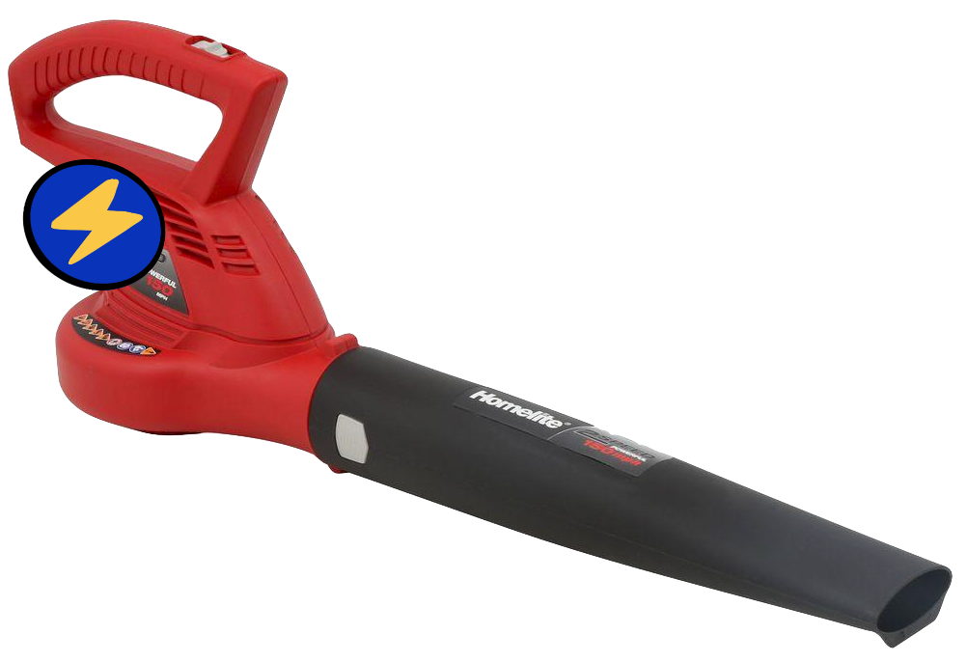
Electric Leaf Blowers
Gas-Powered Leaf Blowers | Electric Leaf Blowers
Pollute nitrous oxides Loud Emit carcinogens and asthma-inducing toxins | Do not pollute on spot Quiet Better for health
Notes:
Now for electrification.
Gas leaf blowers are surprisingly bad for the environment. They emit nitrous oxides, which are 300 times more potent than CO₂.
This means using a gas leaf blower for one hour pollutes the equivalent of driving 1100 miles! They are surprisingly worse for the environment than trucks.
So, I spoke to Mr. Galligan about switching to electric leaf blowers last year. Thanks to Mr. Galligan and the facilities team, we now use electric leaf blowers instead of gas leaf blowers. Not only are they better for the environment, they’re quieter too and do not emit an unhealthy stench.

Slide 7
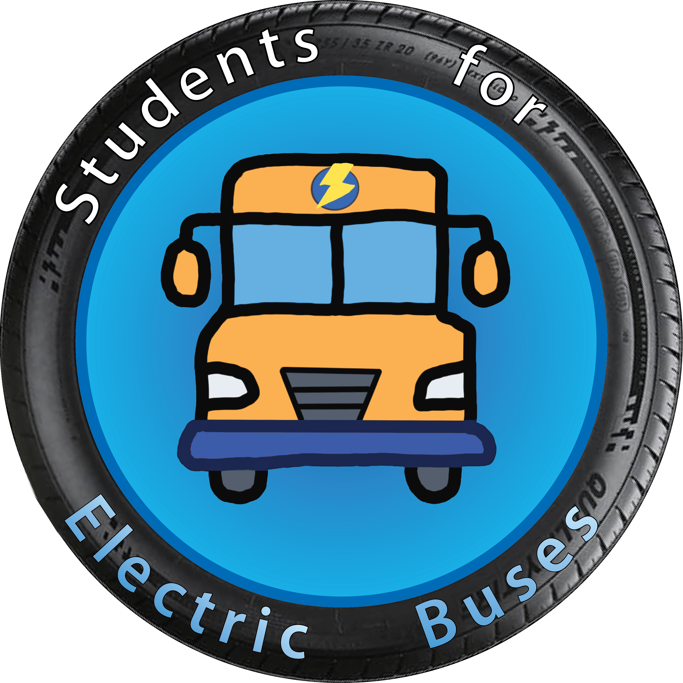

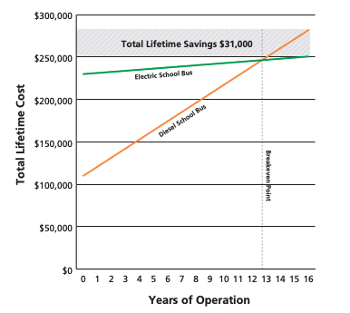
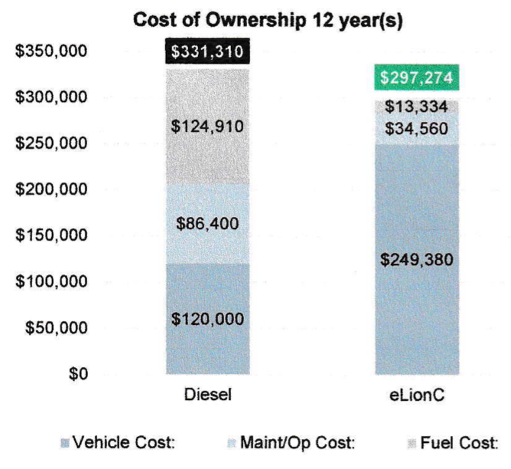
Electric School Buses
+ Lower emissions by 17 MtCO₂e, combating climate change
+ Improves student health (diesel causes asthma)
+ Less pollution
Economics
Over 12 years, electric is cheaper than diesel
Higher upfront cost
Lower cost of fuel and maintenance
Notes:
Electrification
You know what. Can everyone Students for Electric Buses stand up? I want to give them a round of applause.
We have been working to bring electric school buses to Riverdale, Fieldston, and Horace Mann over the last two years. We are meeting with SuperSelby to try to make it work. While public schools have started, it is a new idea for private schools to transition, so we are fighting an uphill battle.
But it is worth it. Every bus transitioned from diesel to electric saves 17 metric tons of CO₂ equivalent, reduces pollution in the city, and reduces passenger’s risk of heart and lung problems later in life.
With the federal, state, and private incentives, we hope to make the financing work in order to gradually transition.

Slide 8
Thank You
Notes:
All of this was possible because of collaboration. Let us work together to improve our infrastructure to stop climate change. Thank you!

